Slide 1
Chapter 1
Introduction to iOS Development

Slide 2
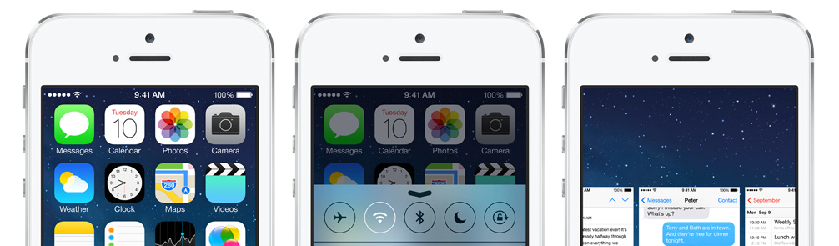
iOS
The world’s most advanced mobile OS.
In its most advanced form.
With an easy-to-use interface, amazing features, and security at its core, iOS 7 is the foundation of iPhone, iPad, and iPod touch. It’s designed to look beautiful and work beautifully, so even the simplest tasks are more engaging. And because iOS 7 is engineered to take full advantage of the advanced technologies built into Apple hardware, your devices are always years ahead — from day one to day whenever.

Slide 3








iOS & iDevices Brief History
01 - 3
iPhone OS to iOS
Multi-tasking & background
Facetime
Retina Display
AirPrint
Local Notification
+1000 features
Siri upgrade
Facebook Integration
Passbook
Apple Map, 3d Flymode & Turn-By-Turn
Collection View
Auto Layout
See the last session
Swift, Extension, and more...
AppStore
First iOS App Dev.
2007
2008
2009
2010
2011
2012
2013
2014
Introduce iPhone
Phone, iPod, Internet
Accelerometer
Pinch, Zoom, natural scrolling,
maps
Focus on Web App, no AppStore yet.
Support VDO recoding
Cut, copy, paste
Spotlight
Push notification
+100 features
iPad
Core Data
Siri
iCloud
Notification Center
iMessage
Newsstand
No PC
Bluetooth LE
iAd
Twitter Integration
Redesign everything
Control Center
iTunes Radio
PassKit
TextKit
64 bit
Multi-tasking Enhancement
AirDrop
Peer-2-Peer

Slide 4
To Develop iOS App
01 - 4
Mac with Most Up-to-date.
Xcode
Objective-C, Swift
Apple ID

Slide 5
Test App on Device
01 - 5
Mac with Most Up-to-date.
Xcode
Objective-C, Swift
Apple ID with Apple Developer Program
Real Device (iPhone, iPod Touch, iPad)

Slide 6
Distribution in AppStore
01 - 6
Mac with Most Up-to-date.
Xcode
Objective-C, Swift
Apple ID with Apple Developer Program
Real Device

Slide 7
Distribution In-House / Enterprise
01 - 7
Mac with Most Up-to-date.
Xcode
Objective-C, Swift
Apple ID with Apple Developer Enterprise Program
Real Device

Slide 8
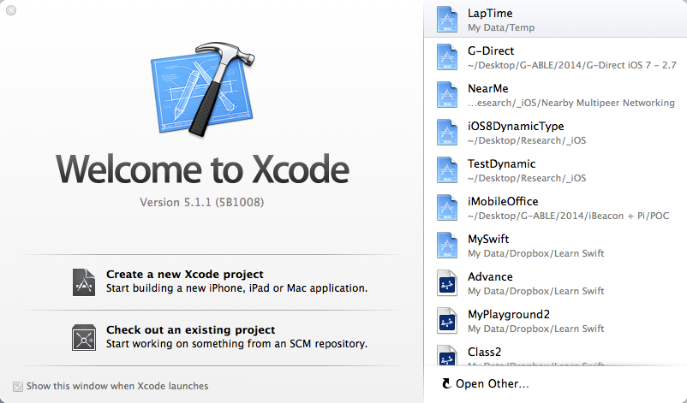
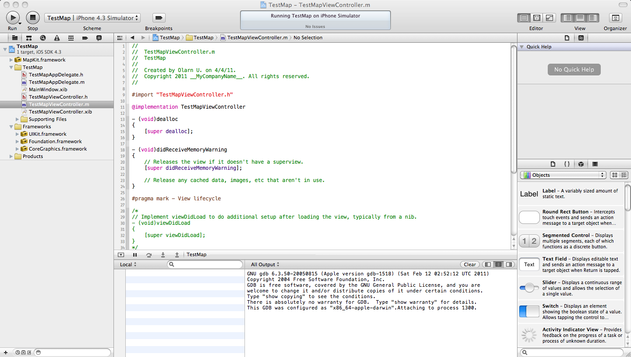
Xcode
01 - 8
Xcode เป็น IDE ที่ใช้พัฒนา application บน iOS และ OS X ทำงานบน OS X และรองรับการเขียนภาษา Objective-C, C, C++, Java, อื่นๆ และ Swift ใน Xcode 6
Free ผ่าน Mac AppStore หรือ download จาก developer portal

Slide 9
Xcode (2)
01 - 9
สร้าง project ใหม่และจัดการกับ project เช่น specifying platforms, target requirements, ผูก dependencies, และ build configurations.
เขียน code ใน code editor ซึ่งรองรับการแสดง syntax เป็นสีต่างๆ coloring และช่วยย่อหน้าหรือเติม code อัตโนมัติ
Navigate และ search ไปยัง components ต่างๆ ใน project, รวมไปถึง header files และเอกสารประกอบด้วย
Build project.
Debug project แบบ localใน simulator, และ remote ไปยังอุปกรณ์ที่ใช้ test โปรแกรม ทั้งในรูปของ graphical และ debug ในระดับ source code.

Slide 10
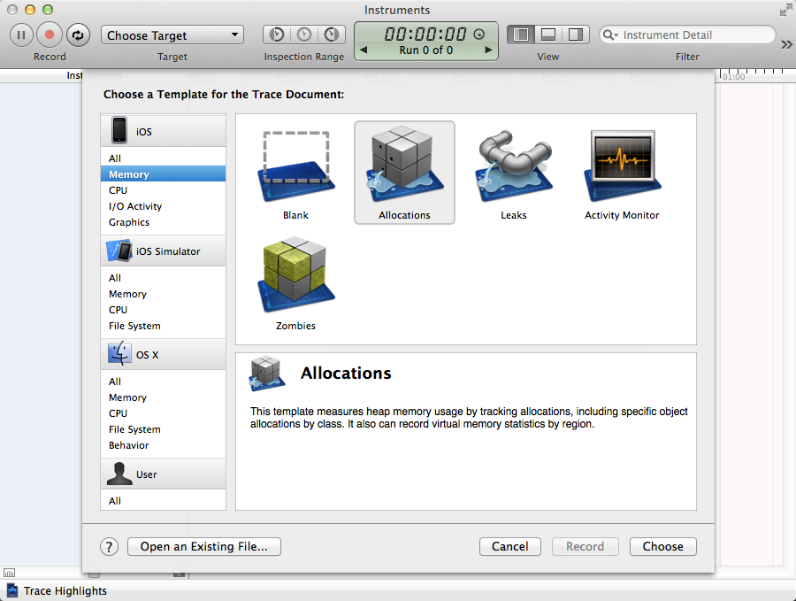
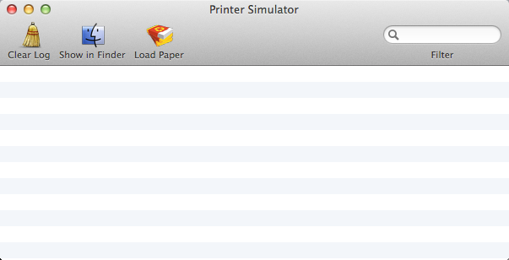
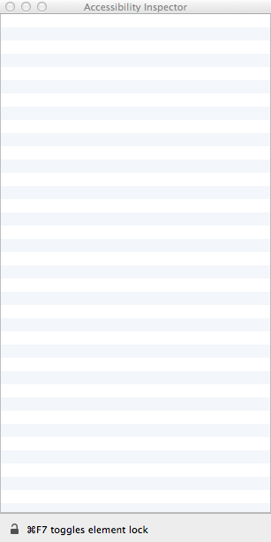
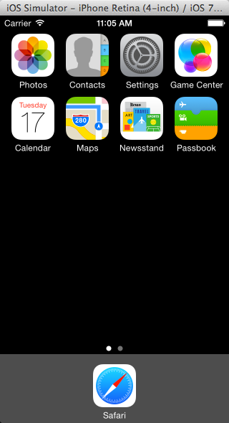
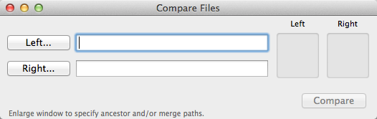
Development Tools

Slide 11
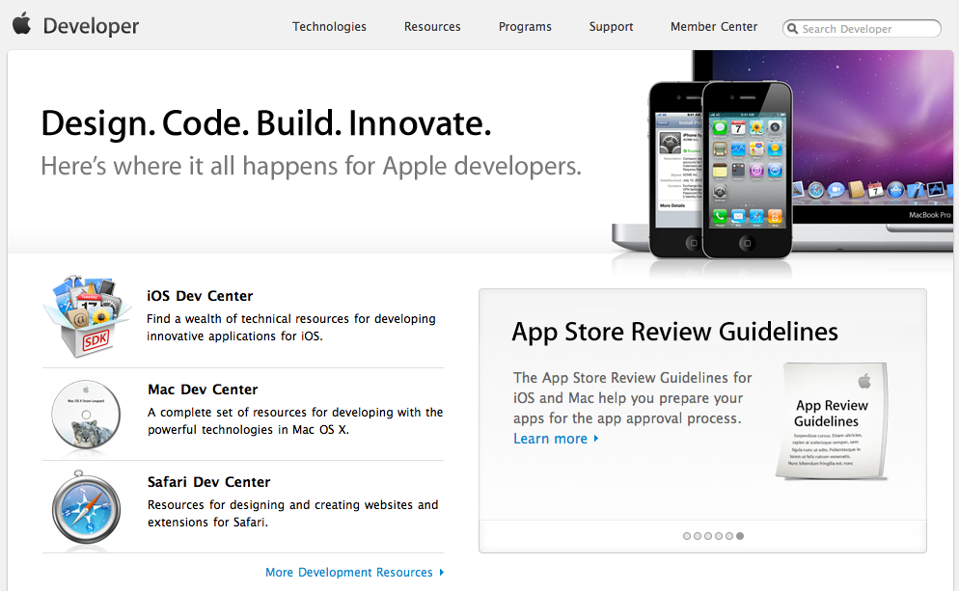
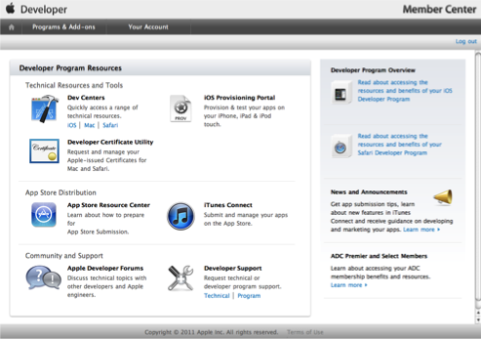
Apple Developer Program
01 - 11
Developer Program
ลงทะเบียน Apple Developer (free)
ศึกษา, พัฒนา, ทดสอบกับ simulator บน Xcode (free ผ่าน Mac App Store)
App for consumer…
You are individual developer or
You are company developer
In-house App
You are Enterprise developer
Deployment
iOS Developer (iTunes App Store)
Mac Developer (Mac OSX App Store)
Volume Licenses
Custom B2B Apps for Business
Last update Sep. 24, 2012

Slide 12

Apple Developer Program
01 - 12
iOS Developer Program
Registration for Free
Free Xcode
$99 / Year
Test on iOS Device
Distribute to AppStore
1 developer account
99 Test Devices
Early Access
iOS Enterprise Program
Free Xcode
$299 / Year (8,990฿)
Requires D-U-N-E-S number
Unlimited developer accounts
99 Test Devices
In-House Distribution
Cannot deploy to Apple AppStore

Slide 13




Enroll in the Apple Developer Program (iOS & Mac Developer)
01 - 13
1. Register as an Apple Developer
If you have not already registered as an Apple Developer, we will walk you through the process so you can complete and submit your enrollment.
2. Select Your Programs
Once you have registered as an Apple Developer, you will select a Program (or Programs) based on the platform you wish to develop for.
3. Complete Your Purchase
After purchasing your Program, you will receive an activation email within 24 hours that provides information on how to access your Program resources.
http://developer.apple.com/programs/start/standard/

Slide 14

Enroll in the Apple Developer Enterprise Program
01 - 14
Before applying please ensure the following:
You plan to only distribute your iOS apps within your company or organization The Enterprise Program is intended for developers who wish to develop and distribute their iOS apps within their company or organization.
Your company has a DUNS Number You will be required to provide us with your Dun & Bradstreet Number during the enrollment process.
You have authority to bind your company to the legal agreements You will need to provide the legal contact who can verify that you have the authority to bind your company to the iOS Developer Program Enterprise License Agreement.

Slide 15
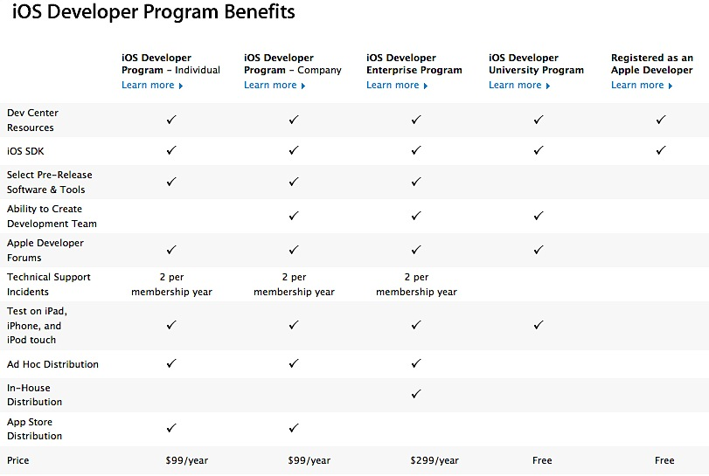
01 - 15

Slide 16
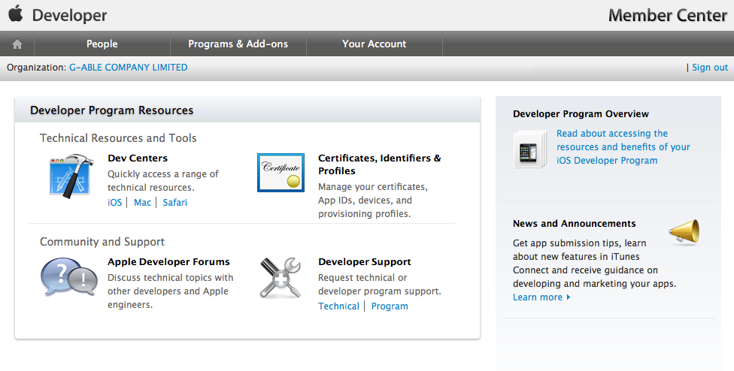
Apple Developer Portal
01 - 16

Slide 17
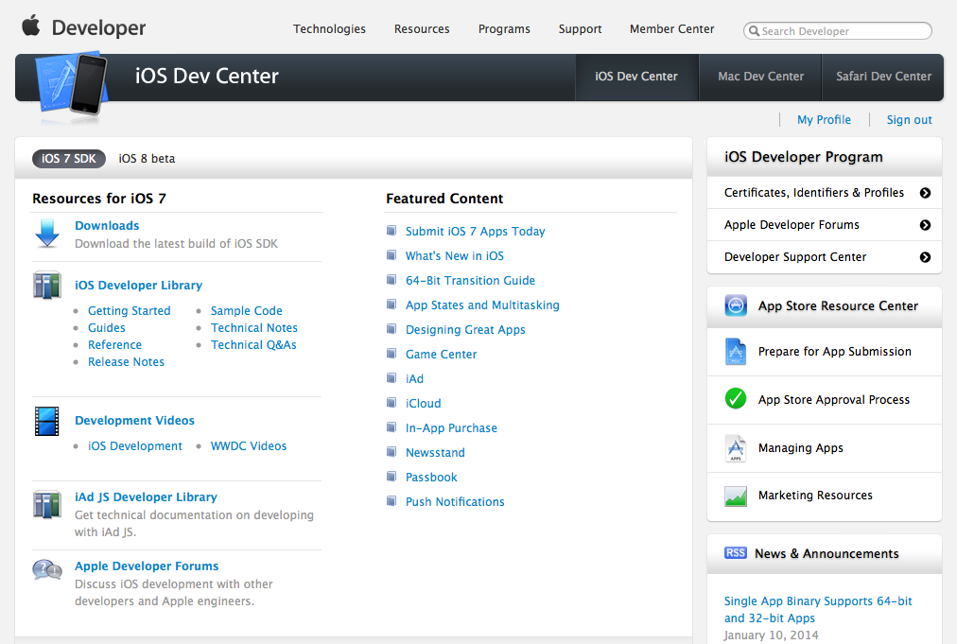
Apple Developer Portal
01 - 17

Slide 18
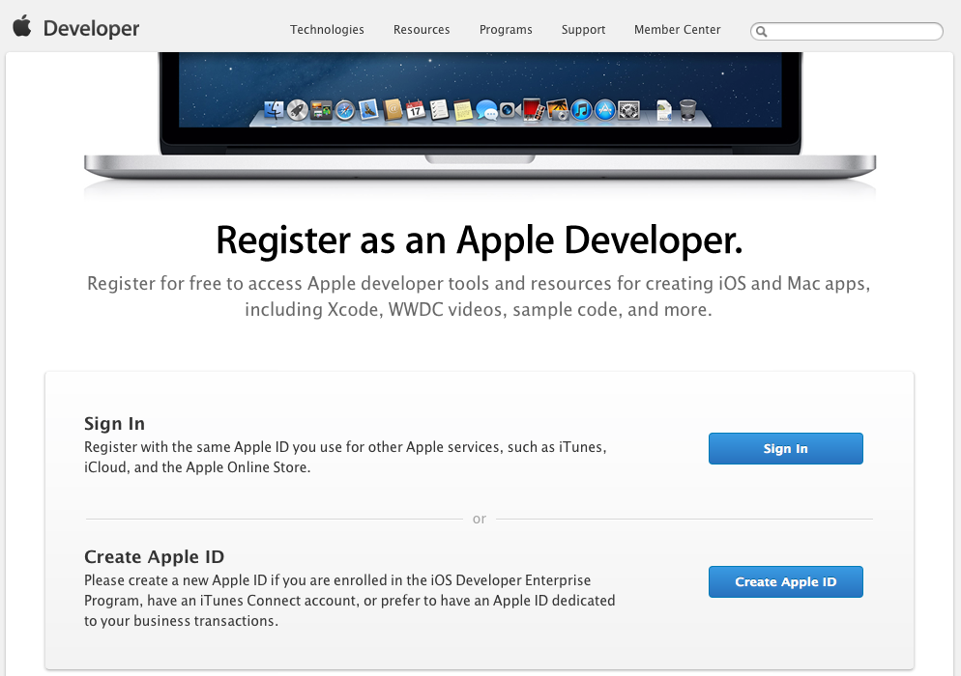
Enterprise Program for G-ABLE Developers
01 - 18
Developer สมัคร Apple ID (ด้วย email ของบริษัท)
Developer สมัคร Apple Developer ID

Slide 19
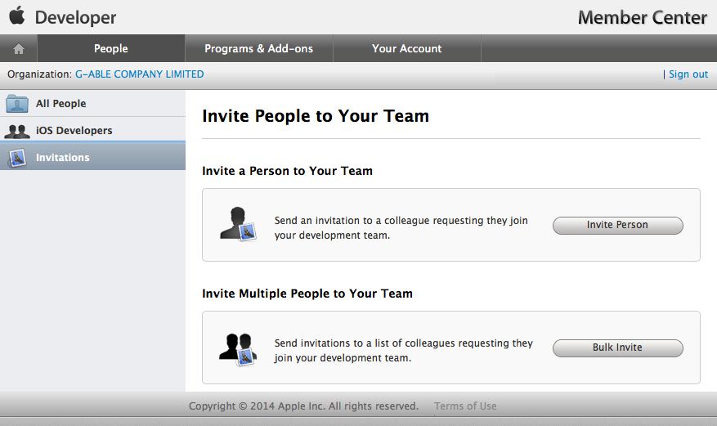
Enterprise Program for G-ABLE Developers
01 - 19
Agent ส่ง Invitation ไปยัง developer, developer accept

Slide 20
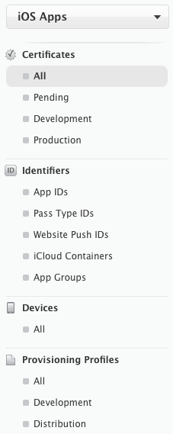
Development Provisioning Profile
01 - 20
สร้าง development certificate
สร้าง App ID, Push Certificates
เพิ่ม Development Devices
สร้าง Development Provisioning Profile
กำหนด member
กำหนด App ID
กำหนด devices
Download provisioning profile

Slide 21
Distribution Provisioning Profile
01 - 21
สร้าง App ID (ใช้อันเดียวกับ development)
สร้าง Push Certificates สำหรับ production
สร้าง Development Provisioning Profile
เลือก distribution certificate (ทั้ง account มีตัวเดียว)
กำหนดว่าเป็น In-house
กำหนด App ID
Download Provisioning Profile

Slide 22
Resources
01 - 22
Apple Developer Portal https://developer.apple.com
WWDC Session videos https://developer.apple.com/videos/
Swift Language https://developer.apple.com/swift/
Enterprise & (some) Edication Guideline https://developer.apple.com/enterprise/
Best practices for iOS App http://www.objc.io

Slide 23
Before continue…
01 - 23
Do you ever use Mac?
No? Let’s play Mac & OS X.
Magic Mouse, Keyboard
Finder, Folder Structure, Copy, Paste, Move
Language Switcher (keyboard)
Docking, Application Folder
Spotlight, Launchpad, Mission Control, Full screen, Quick Look, Preview
System Preferences (Control Panel)
Network & Proxy
Terminal
Activity Monitor
Shutdown, Restart

